Slide 1
Supervised learning

Slide 2
What is supervised learning?
Have labels for data

Slide 3
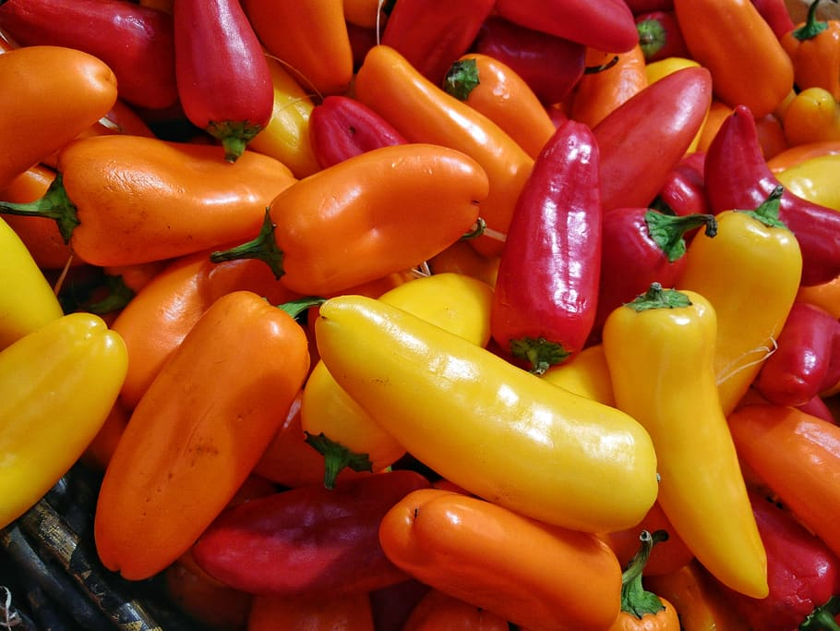
What is supervised learning?
Have labels for data
Peppers

Slide 4
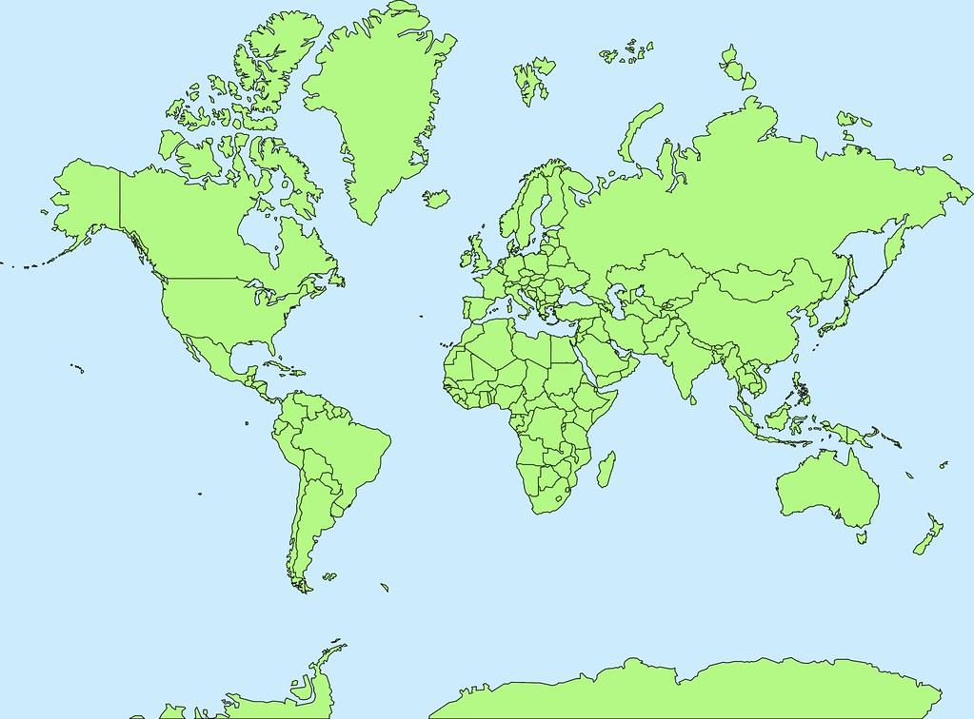
What is supervised learning?
Have labels for data
Peppers
Map

Slide 5
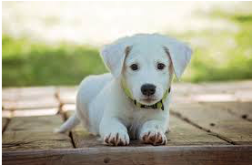
What is supervised learning?
Have labels for data
Peppers
Map
Dog

Slide 6
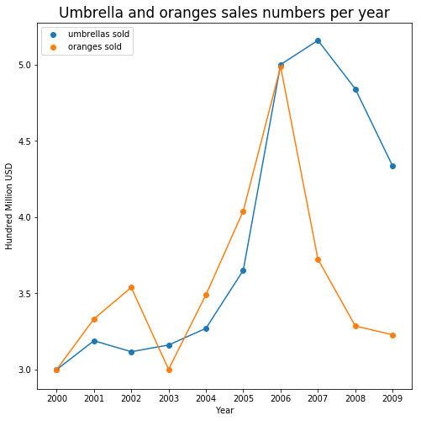
What is supervised learning?
Have labels for data
Numerical Data

Slide 7
What is supervised learning?
Have labels for data
Train an algorithm to predict target values based on given set of features
Numerical Data

Slide 8
What is supervised learning?
Have labels for data
Train an algorithm (model) to predict target values based on given set of features
We know the “right answer” and can give our algorithm appropriate feedback
Numerical Data

Slide 9
What is a model?
A model is a representation of reality
Refers to a specific algorithm, or set of algorithms, that have been trained to perform a particular problem
Numerical Data

